Slide 1
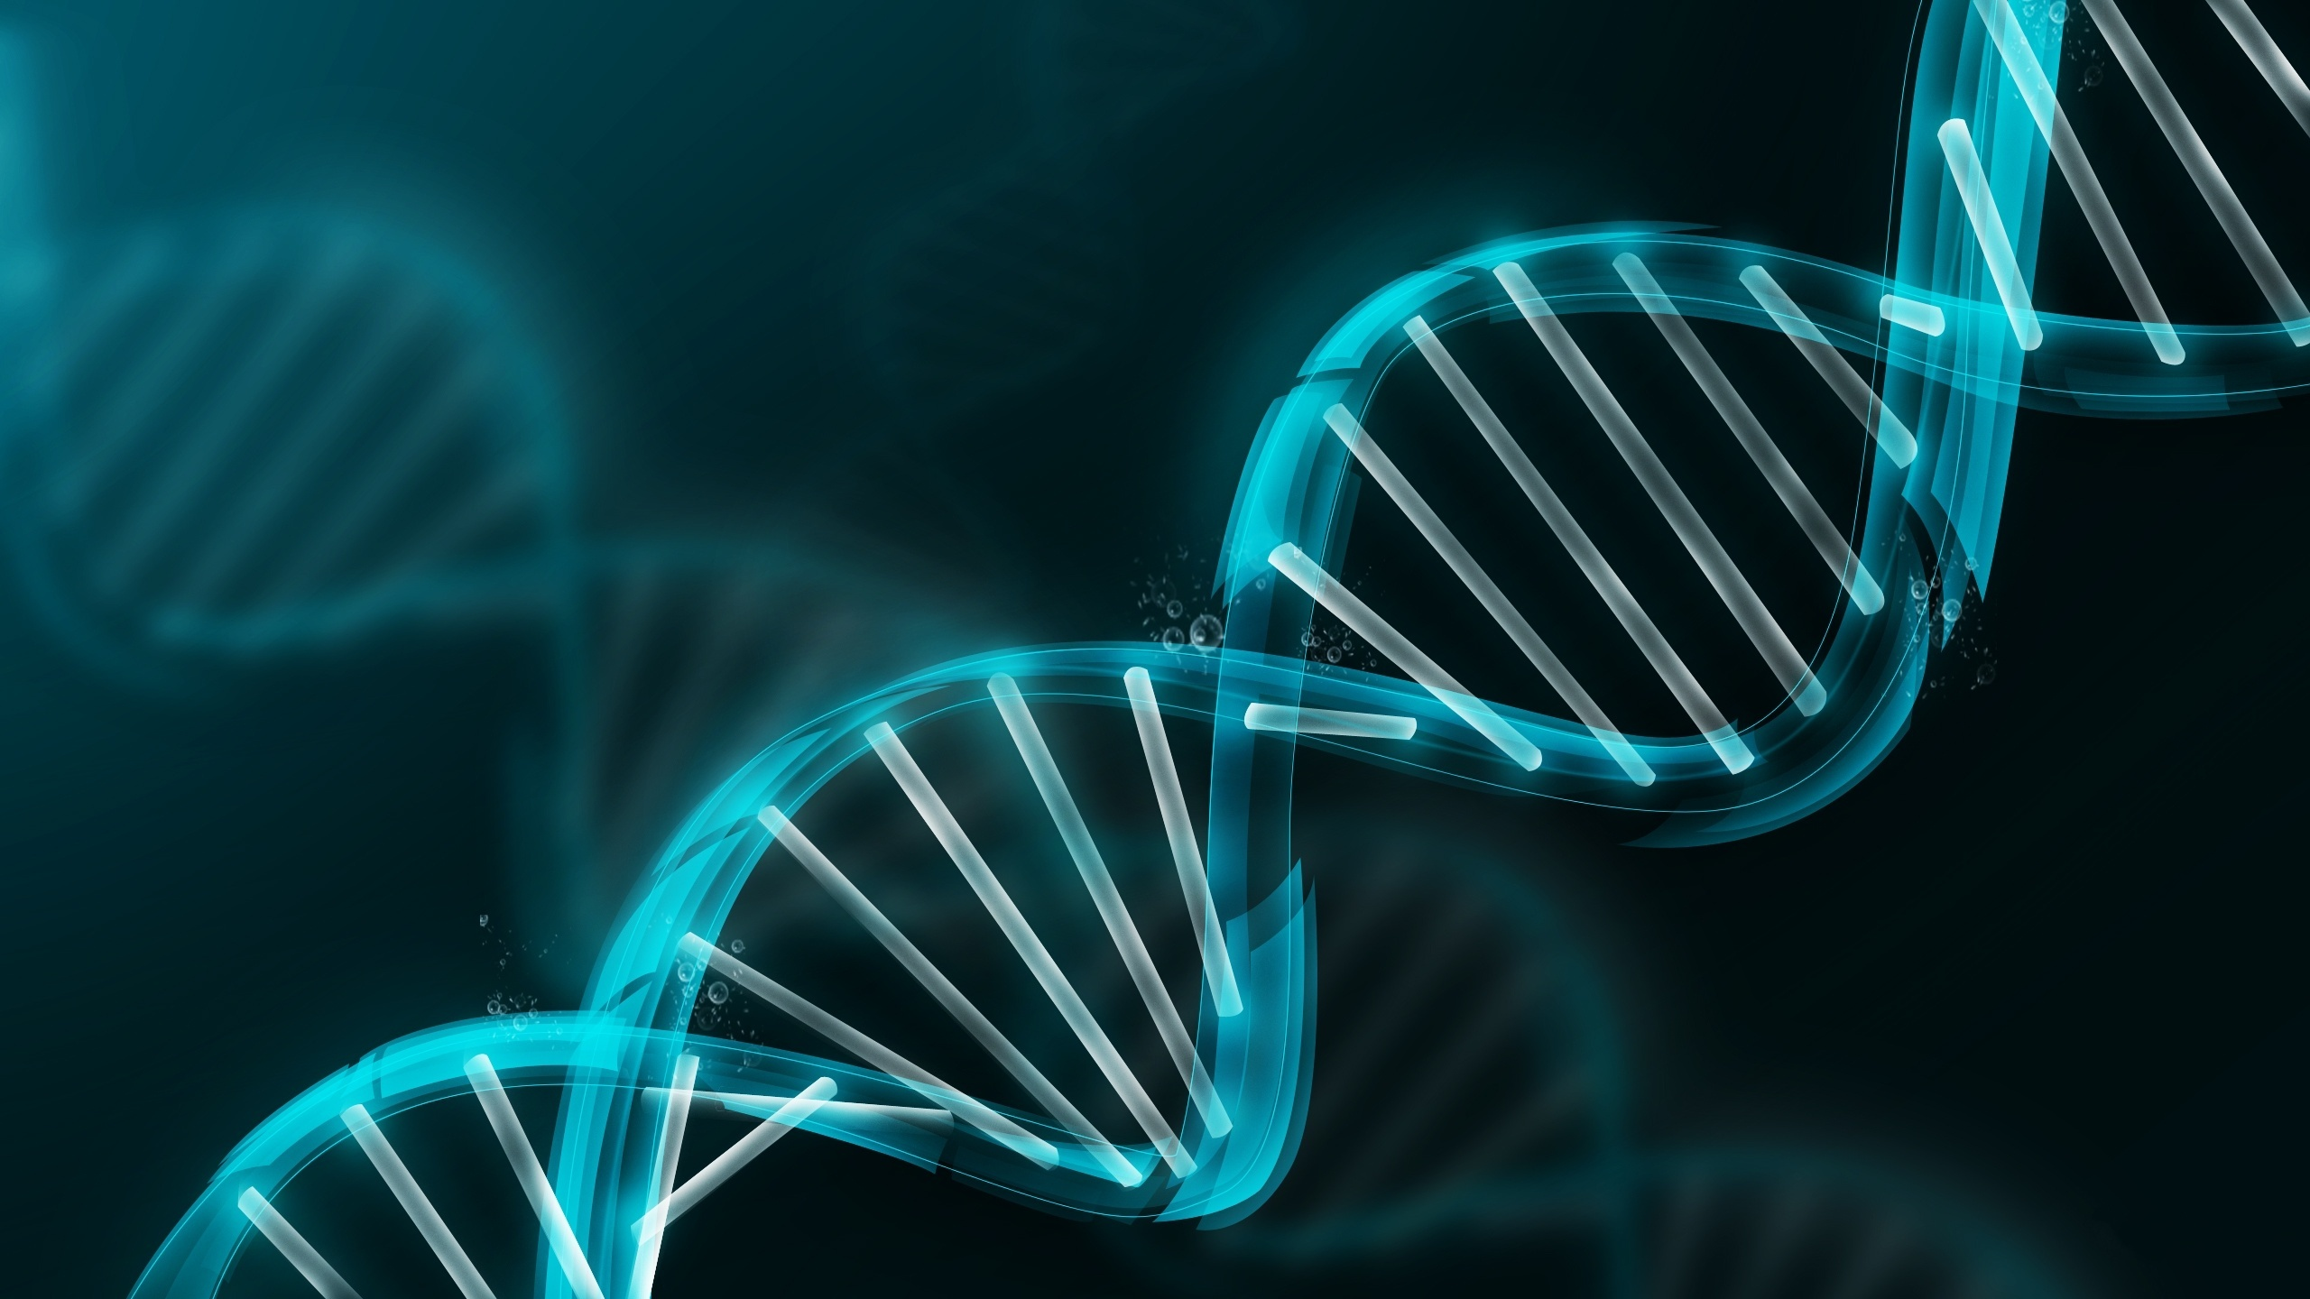

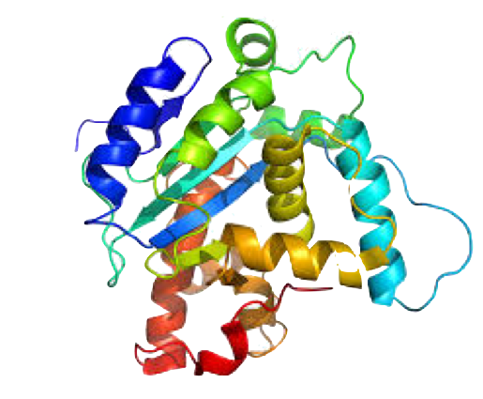
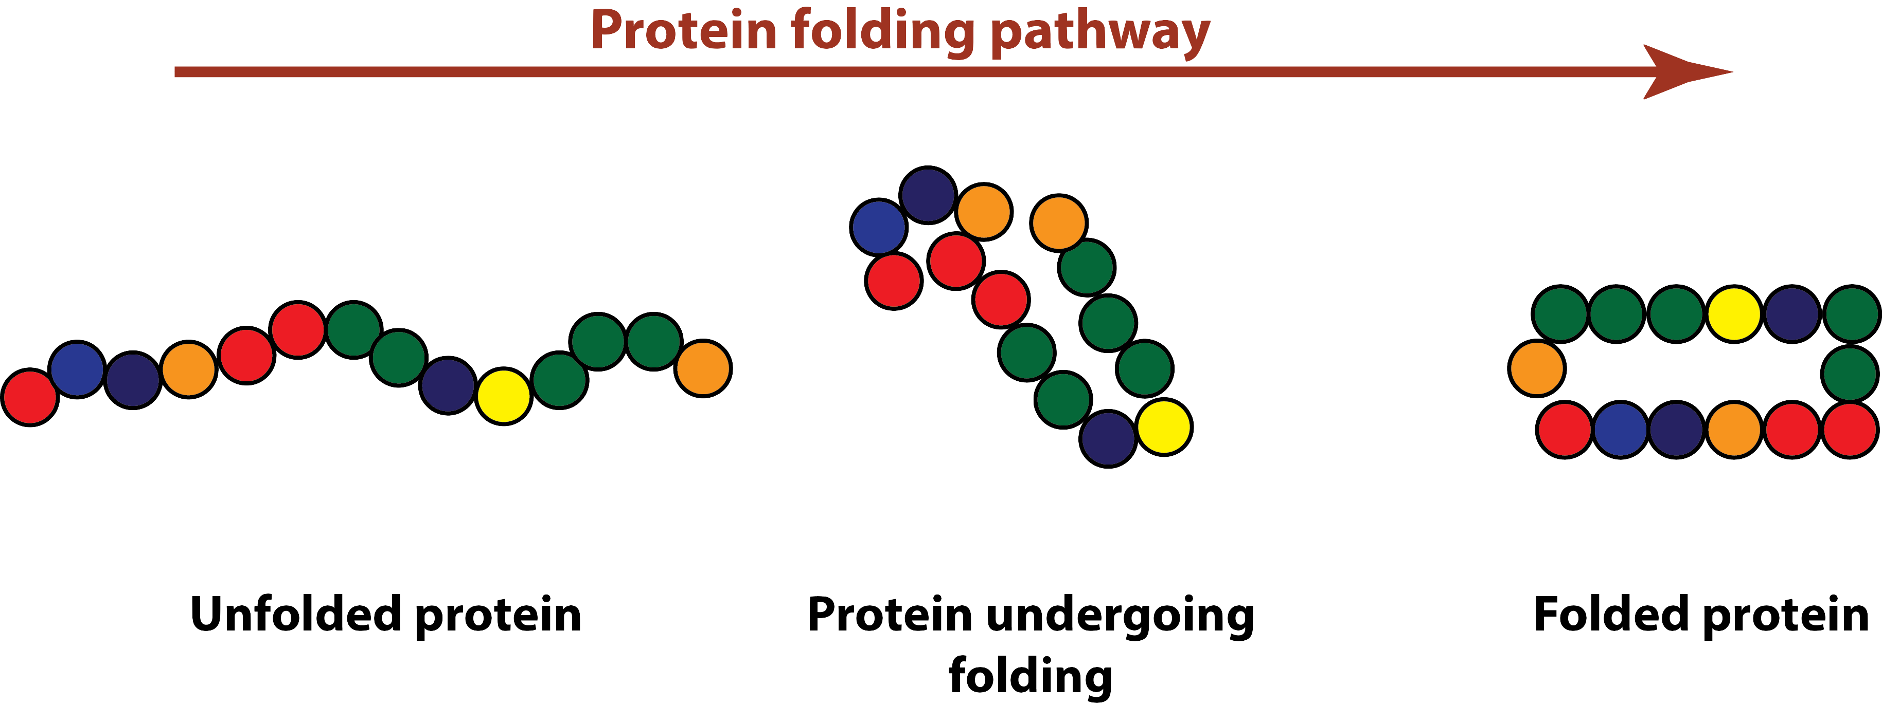
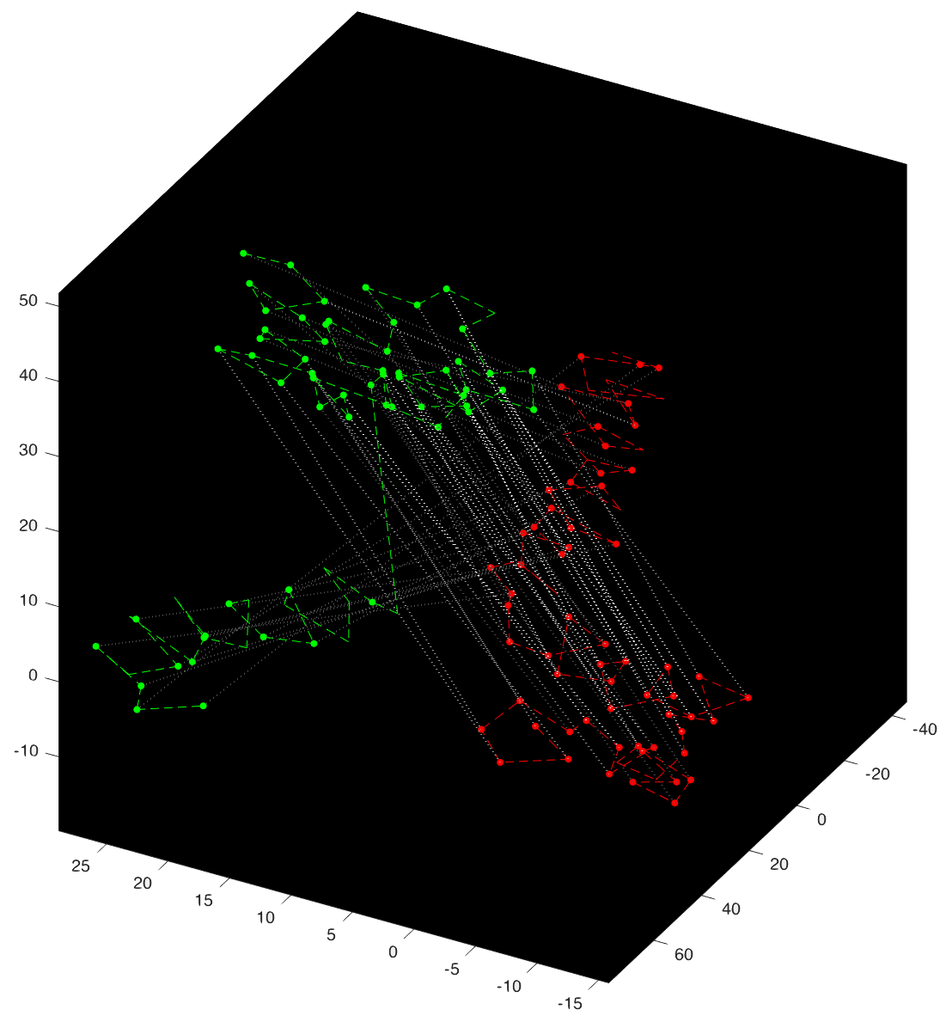
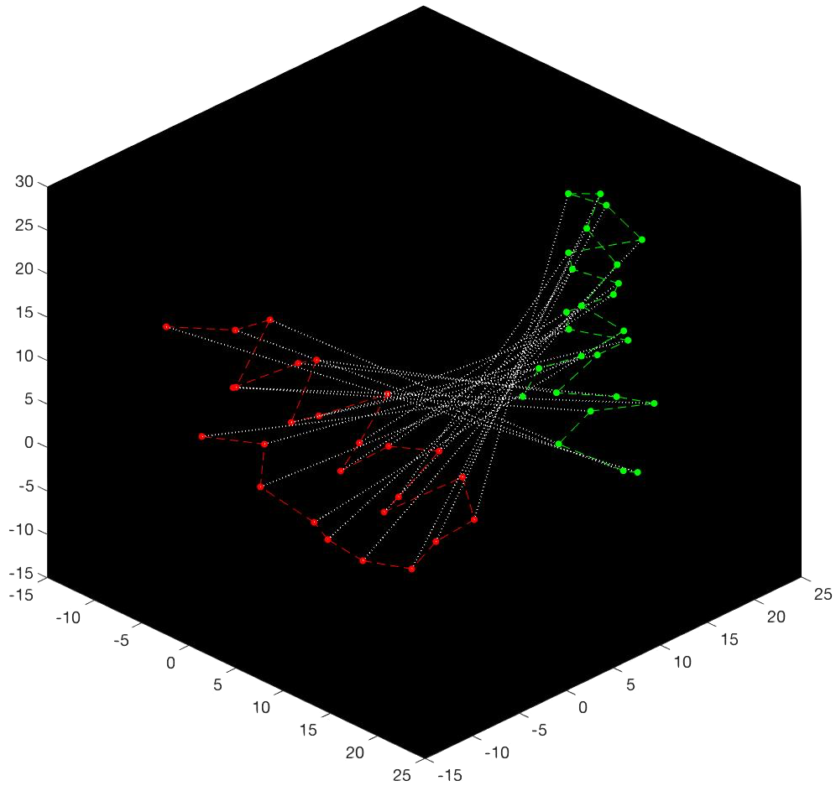
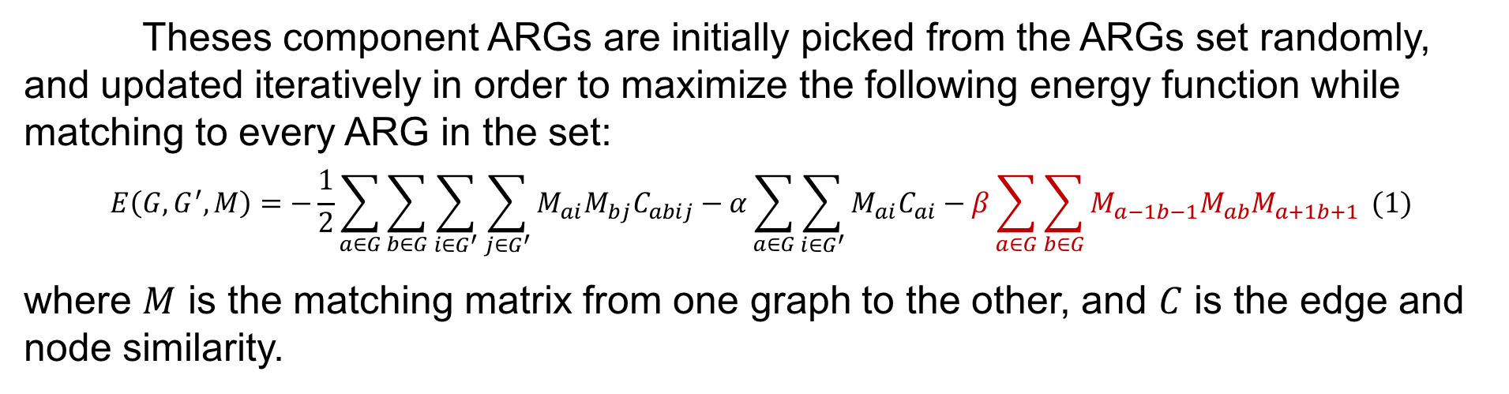
Graph Matching, Pattern Learning, and Protein Modeling
Wei Qian, Pengyu Hong | Computer Science Department, Brandeis University, Waltham, MA, USA
I. Introduction
II. Method
When feeding in proteins with CH1 domain, the trained components ARGs successfully capture the CH1 domain pattern, and easily distinguished the CH1 domain pattern from random protein patten even when the sequence is reversed, or partitioned into a different order:
One of the most amazing capabilities of human beings is to extract common spatial patterns from observations and use these patterns to make inference. For example, even if you do not know Woody and I tell you that below are two pictures of him, you will most likely be able to recognize him since he is the only person (i.e. the spatial pattern in our case) showing up in both pictures:
To discover pattern in protein, we first turn their 3D structure into a ARG to represent their spatial relationship where nodes represent individual amino acid in the protein and edges represent a closed distance between the two amino acids:
Then to learn the common patterns among these ARGs, we tried to use some small number of special ARGs (as our component ARGs) to represent the entire set of sample ARGs:
IV. Discussion
To represent these spatial patterns, we utilized a graph representation in computer science called ARGs (attributed relational graphs) consisting of labelled nodes connected by labelled edges:
When trying to compare two proteins, we used an efficient graph matching algorithm developed by Gold and Rangarajan in 1996. However, their algorithm does not work well enough for large graph like protein structure, so we make the following improvements which gives us a significant performance boost for matching two proteins:
1) introduce random noise to avoid suboptimal solution
2) introduce a null network to match background noise
Sample ARGs
Summarize Square Pattern
Summarize House Pattern
Component ARGs
and we build algorithms to compare different ARGs (this is called graph matching/graph alignment) and extract the common pattern (the orange part) while ignore the background noise (the purple, black, and blue part) from the ARGs (this is called pattern learning).
Theses component ARGs are initially picked from the ARGs set randomly, and updated iteratively in order to maximize the following energy function while matching to every ARG in the set:
$$E\left(G,G^{′},M\right)=−\frac{1}{2}\sum_{a∈G}{\sum_{b∈G}{\sum_{i∈G^{′}}{\sum_{j∈G^{′}}{M_{ai}M_{bj}C_{abij}}}}}−α\sum_{a∈G}{\sum_{i∈G^{′}}{M_{ai}C_{ai}}}−β\sum_{a∈G}{\sum_{b∈G}{M_{a−1b−1}M_{ab}M_{a+1b+1}}} (1)$$
where $M$ is the matching matrix from one graph to the other, and $C$ is the edge and node similarity.
One important application of such algorithms would be modeling proteins in their 3D structures. Proteins are macromolecules responsible for nearly every task of cellular life. They are first generated by DNA (the poster background!) as a linear sequence of amino acids and then folded as a 3D structure in order to function:
Even though the reason we used the 3D structure is to discover pattern hidden in the linear structure, we still introduced a linear match term shown in red for equation (1) since most of the match will still be linear and the red term can give us a clearer and more feasible result.
Currently, we are using a BLOSUM matrix to model the similarity between nodes (amino acids). However, such representation does not consider the neighboring amino acids, and therefore not the most accurate model for amino acid. While it is not reported here, we are working on a solution try to model the similarity between amino acids considering its local information, which can also be interesting for biologist investigating protein formation
For our next step, we would like to test the model on a more diverse data set in order to discover protein structure patterns that are finer than the domain pattern.
III. Result
Our matching algorithm based on equation (1) can generate correct match between protein 3D structure shown are the left where very similar structure has a very bright match:
Conventional computational methods model proteins in their unfolded sequence form, and ignore the 3D nature of proteins. By modeling protein in their 3D structure and taking advantage of the available 3D structure data, our algorithms have the potential to discover new structure patterns in proteins that are impossible to discover in their linear structure.
V. Acknowledgement
This work is supported by the Jerome A. Schiff Fellowship, and I thank Prof. Pengyu Hong for his continuous support, inspiration and guidance.

